Slide 1
Twitter/X
Group 3

Slide 2
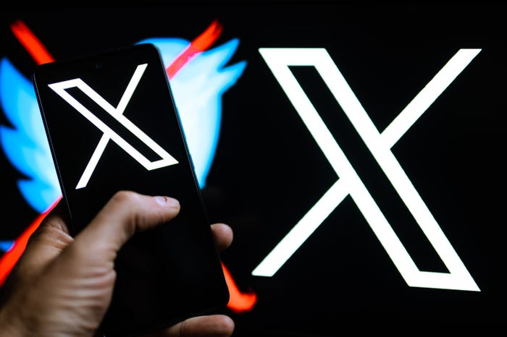
Agenda
Background of Twitter/X
Twitter Over the Last 10 Years
BI & Analytics Systems
Related Case Studies
Dataset Overview

Slide 3
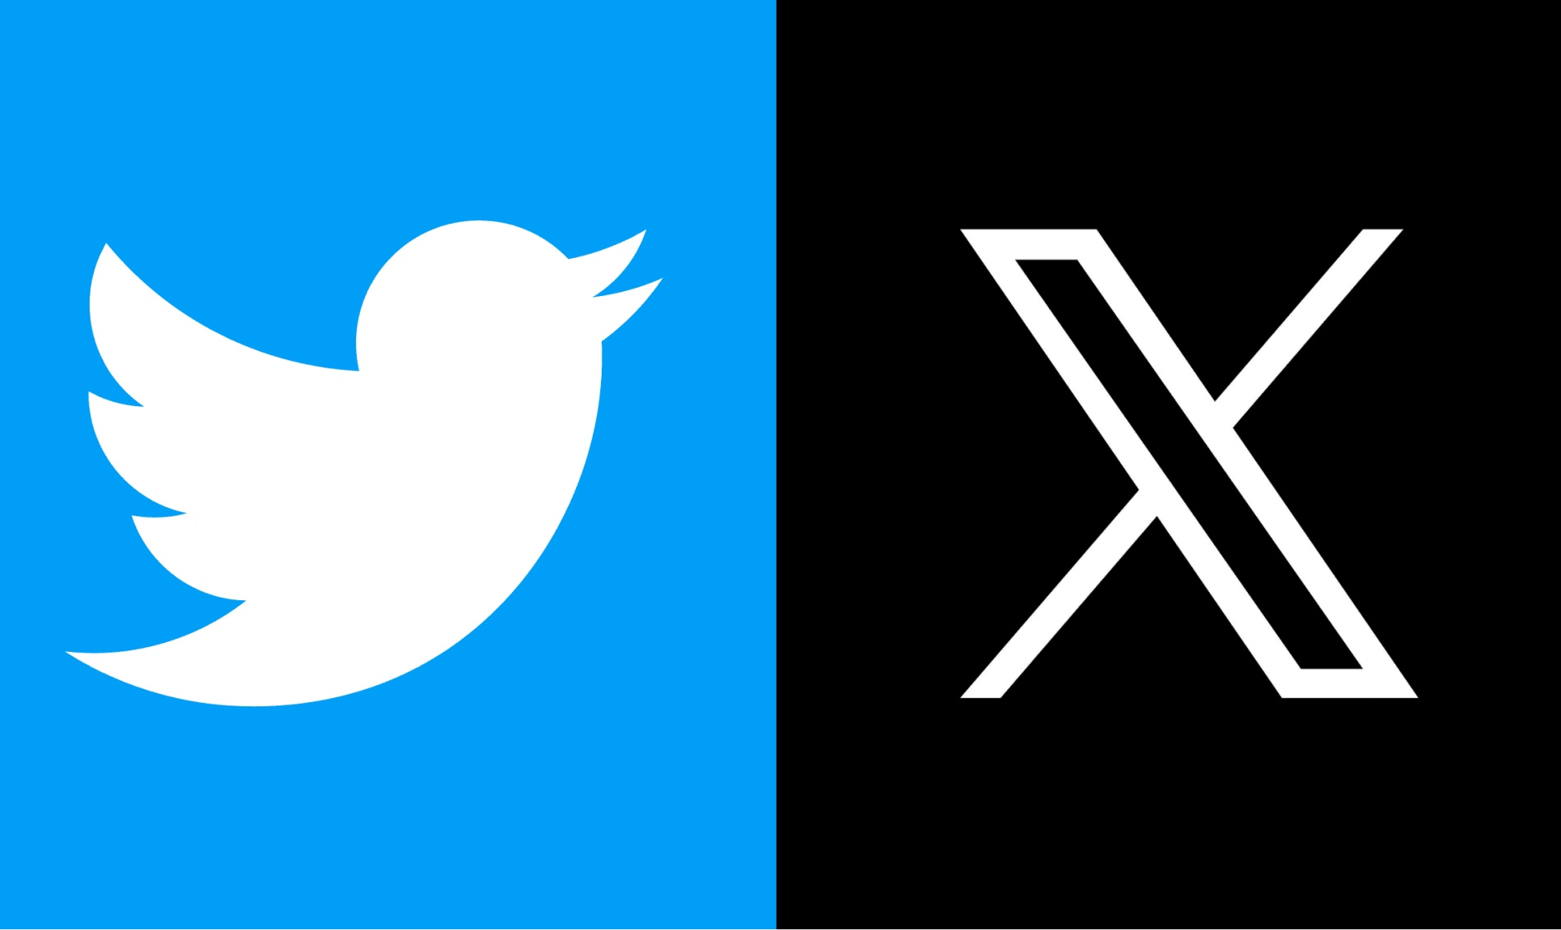
Background of Twitter
Twitter, now known as X was created in 2006 by Jack Dorsey, Noah Glass, Biz Stone and Evan Williams
Social Media Company with primary product being a Social Media Platform Twitter
Allows for users to “tweet” social media posts up to 280 characters
Many companies use Twitter/X as a Digital Marketing Tool as well.
Recently rebranded as X after company was bought out by Elon Musk for $44 Billion
Made company privately owned
Headquartered in San Francisco, California

Slide 4
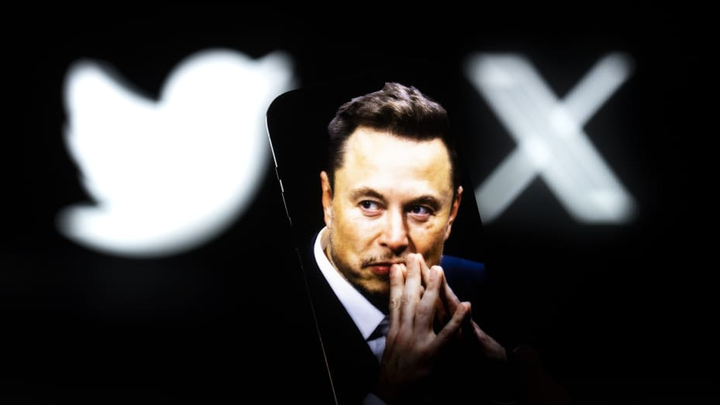
Background of Twitter Continued
After Elon Musk took over, he laid off 80% of the staff, leaving the company with 1,500 Full time employees
Has a market cap of $41.09 Billion making it the 468th most valuable company in the world
Largest markets in United States, Germany, and the United Kingdom
Most employees are engineers, ensuring the platform is working smoothly

Slide 5
Twitter Over Last 10 Years
Growth and Evolution:
User Base: While the platform boasts over 335 million monthly active users as of 2024, user growth has plateaued in recent years.
Character Limit: The iconic 140-character limit was doubled to 280 in 2017, offering users more space to express themselves.
Features: New features like live-streaming (Periscope acquisition in 2015), polls, and threaded tweets have been introduced, fostering more interactive and engaging content.
Revenue: Revenue has grown from $1.4 Billion to $4.8 Billion from 2014-2023
Challenges and Shifts:
Monetization: Advertising revenue has faced challenges in recent years, while efforts in subscription and data licensing haven't fully compensated.
Content Moderation: Issues like misinformation and online abuse have necessitated ongoing efforts to improve content moderation and user safety.
Shifting Landscape: The rise of other social media platforms, particularly those emphasizing visual content, has presented ongoing competition.

Slide 6
BI & Analytics Systems
MS Excel Usage: Twitter (X) does not rely heavily on excel
Data Warehouses: Twitter (X) utilizes data warehouses to store and manage their vast amount of data efficiently. They use Hadoop, HDFS.
Integrated Information Systems (IS): Twitter (X) leverages seamless and integrated IS to streamline their reporting and analytics processes, integrating data from various sources.(Gizzard, T-Bird, T-Flock, Snowflake, FlockDB , MySQL)
BI Team: Twitter (X) they have a dedicated BI team responsible for developing and maintaining their reporting and analytics systems.
Primarily use Hadoop for analytics

Slide 7
BI & Analytics Systems Continued
BI Tool/Reporting System: Twitter (X) specific BI tools and reporting systems tailored to their needs and scale. Examples could include Tableau, Looker, or custom-built solutions.
In-house vs. Purchased System: Twitter (X) uses Ambrose for BI and to create data visualizations. X Views is a customer facing BI tool that can give insights to accounts on their impressions and reach.
BI Maturity Model: Twitter (X) is likely positioned at an advanced stage on the BI maturity model, possibly at the "Analytical Competency" or "Advanced Analytics" stage.

Slide 8

Case: Starbucks
Scenario: Starbucks, the global coffee giant, leverages BI to enhance its marketing, sales, and business decisions.
Approach:
Through its popular loyalty card program and mobile application, Starbucks collects individual purchase data from millions of customers.
Using this information and BI tools, the company predicts purchases and sends personalized offers to customers via their app and email.
Starbucks encourages existing customers to visit its stores more frequently, thereby increasing sales volumes.

Slide 9

Case: Netflix
Scenario: Netflix, the online entertainment company, capitalizes on its massive subscriber base (148 million) to gain a BI advantage.
Approach:
Netflix digitizes interactions with its 151 million subscribers, collecting data on user behavior and watching patterns.
The company uses data analytics to understand subscriber preferences and recommends customized movies and TV shows.
Around 80% of viewer activity is triggered by personalized algorithmic recommendations.

Slide 10
Data Set Overview (Source: Kaggle)
Twitter(X)
Information: Total users Year based, number of tweets, number of re-tweets, number of tweet impressions, number of customers by country.

Slide 11
References
https://www.cnn.com/2023/04/12/tech/elon-musk-bbc-interview-twitter-intl-hnk/index.html#:~:text=Elon%20Musk%20has%20laid%20off,the%20time%20of%20his%20acquisition.
https://companiesmarketcap.com/twitter/marketcap/#:~:text=Market%20cap%3A%20%2441.09%20Billion,cap%20according%20to%20our%20data.
https://companiesmarketcap.com/twitter/marketcap/
https://www.tipranks.com/stocks/twtr/financials/income-statement
https://www.tipranks.com/stocks/twtr

Slide 12
Thanks for Listening!
Questions?

Slide 13
Twitter's transformation into X
Positive Consequences:
Negative Consequences:
Decentralization and Feature Experiments: Moving towards a more decentralized model could attract developers and encourage faster innovation of new features.
Potential New Revenue Streams: X's focus on payments and e-commerce could open up additional revenue opportunities beyond traditional advertising models.
Addressing Moderation: Musk claims to have made progress in reducing hateful content and improving moderation, though the effectiveness of these changes is debated.
Loss of Trust: The chaotic rollout, mass layoffs, and sudden policy changes have eroded trust among users and advertisers.
User Exodus: The platform has reportedly seen a decline in active users and influential accounts, indicating dissatisfaction with the changes.
Advertiser Flight: Major brands have paused or reduced advertising spending due to concerns about content and the platform's direction. This impacts X's core revenue stream.
Technical Issues: Reports of increased glitches, feature errors, and slowdowns could be due to staffing reductions and rushed changes.

Slide 14

CEOs of Twitter in the Last 10 Years (2014-2024)
Dick Costolo (again, as interim CEO) (June 2021 - November 2021):
Impact: Costolo's brief return as interim CEO didn't have a significant long-term impact on Twitter, as his tenure was relatively short.
Parag Agrawal (2021 - 2022):
Mixed: Focused on addressing misinformation and user safety, with limited impact on user growth and revenue.
Elon Musk (2022 - 2023) & X Corp. (Present):
Significant Change: Twitter became private under Musk's leadership and later merged with X Holdings, becoming X Corp. in April 2023.
Uncertain: The long-term impact of this shift and Musk's vision for the platform are yet to be seen. Current information on user numbers and financials is limited due to the private ownership.

Slide 15
Twitter Growth over the past 10 years
User Growth: Starting from 255 million in 2014, the user base shows a steady increase, reaching 386 million by 2023. This reflects a consistent but relatively modest growth in the platform's user base over the period.
Revenue Growth: Revenue begins at $1.4 billion in 2014 and grows to $4.8 billion by 2023. This trend indicates a healthy increase in Twitter's revenue, suggesting improvements in monetization strategies and possibly expanding advertising and partnership revenues.
Stock Value: The stock value experiences more volatility compared to the other metrics, with significant fluctuations throughout the decade. It starts at $38, peaks at $60, and settles at $52 by the end of the period. This volatility could reflect market reactions to Twitter's performance, changes in leadership, or broader economic conditions.

Slide 16
Twitter Performance
Financials
Stock analysis
Link
Link

Slide 17

CEOs of Twitter in the Last 10 Years (2014-2024)
Dick Costolo (2010 - July 2015):
Positive: Oversaw Twitter's IPO in 2013, marking a significant milestone for the company.
Neutral: User growth remained steady, with the platform establishing itself as a major news source.
Negative: Faced criticism for handling of harassment and abuse issues.
Jack Dorsey (Interim CEO in 2015, and then from July 2015 - October 2015, and again from July 2017 - November 2021):
Positive: Re-energized the platform with features like live video (Periscope) and increased character limit (280).
Neutral: User growth remained stable, but revenue growth slowed down.
Negative: Continued issues with harassment and misinformation.

Slide 18
Twitter's transformation into X
User Retention and Growth: If X fails to attract new users or retain those who feel alienated, the platform's reach and influence may diminish.
Regulation and Scrutiny: X may face increased regulatory pressure and scrutiny due to shifting policies and concerns about data privacy.
Competitors: The instability following the change has provided an opening for competitors and alternative platforms to establish themselves.
Overall, the transformation to X has been a highly disruptive and risky move. While potential benefits exist, the platform faces significant challenges in stabilizing, building trust, and finding new sources of revenue.
The transformation to X is very recent, and long-term consequences remain unknown. Here are factors to consider:

